Slide 1
SQL Best Practices

Slide 2

Lesson Agenda
Coding Standard/Convention
Write query effectively

Slide 3
SQL Coding Standard
Section 1

Slide 4

SQL Coding Standard
Standardization has a positive impact on any business. It requires consistent efforts and sheers the focus of the software development team to meet quality goals.

Slide 5

SQL Coding Standard

Slide 6
Naming convention and styles
Use UPPER CASE for all T-SQL constructs, excepts Types
Correct:
SELECT MAX([Salary]) FROM dbo.[EmployeeSalary]
Incorrect:
SELECT max([Salary]) from dbo.[EmployeeSalary]
Use lower case for all T-SQL Types and Usernames
Correct:
DECLARE @MaxValue int
Incorrect:
DECLARE @MaxValue INT

Slide 7
Naming convention and styles
Use Pascal casing for all UDO’s
Correct:
CREATE TABLE dbo.EmployeeSalary
(
EmployeeSalaryID INT
)
Incorrect:
CREATE TABLE dbo.Employeesalary
(
EmployeesalaryID int
)

Slide 8
Naming convention and styles
Avoid abbreviations and single character names
Correct:
DECLARE @RecordCount int
Incorrect:
DECLARE @Rc int
UDO naming must confer to the following regular expression ([a-zA-Z][a-zA-Z0-9]).
Do not use any special or language dependent characters to name objects. Constraints can use the underscore character.
Correct:
CREATE TABLE dbo.[EmployeeSalary]
Incorrect:
CREATE TABLE dbo.[Employee Salary]

Slide 9
Naming convention and styles
Use the following prefixes when naming objects
usp_: User stored procedures
ufn_: User defined functions
view_: Views
IX_: Indexes
usp_: User stored procedures
DF_: Default constraints
PK_: Primary Key constraints
FK_: Foreign Key constraints
CHK_: Check constraints
UNI_: Unique constraints
Correct:
CREATE PROCEDURE dbo.usp_EmployeeSelectAll
Incorrect:
CREATE PROCEDURE dbo.EmployeeSelectRetired –-without preffixed

Slide 10
Naming convention and styles
Name tables in the singular form
Correct:
CREATE TABLE dbo.[Employee]
Incorrect:
CREATE TABLE dbo.[Employees]
Tables that map one-to many, many-to-many relationships should be named by concatenating the names of the tables in question, starting with the most central table’s name.
Correct:
CREATE TABLE dbo.[EmployeeSalary]

Slide 11
Advantages of Implementing Coding Standards
Enhanced Efficiency
Risk of project failure is reduced
Minimal Complexity
Easy to Maintain
Bug Rectification
A Comprehensive Look
Cost-Efficient

Slide 12
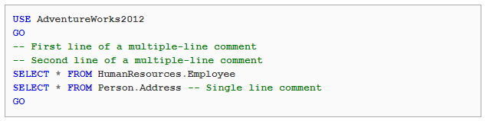
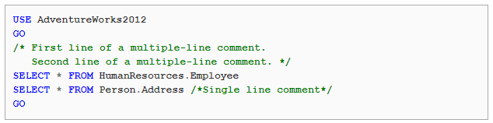
SQL Coding Standard
SQL Comment
Microsoft SQL Server supports two types of comments:
Line comment:
Block comment:

Slide 13
SQL Coding Standard
SQL Comment
Always use comment to explain your code.
Use natural/human language in comment to easy understand.
All comments should be same format.
Break comment line to avoid horizontal scroll bar.

Slide 14
SQL Coding Standard
Naming conventions
Ensure the name is unique and does not exist as a reserved keyword.
Names must begin with a letter and may not end with an underscore.
Avoid abbreviations and if you have to use them make sure they are commonly understood.

Slide 15
SQL Coding Standard
Naming conventions
Use a collective name or, a plural form for table names
Never give a table the same name as one of its columns and vice versa
Always use the singular name for columns.
Use table/column aliases for easier reading

Slide 16
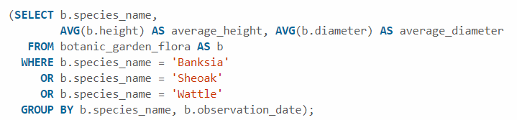
SQL Coding Standard
Format code
Always use uppercase for the reserved keywords like SELECT and WHERE.
Break line to avoid horizontal scroll bar. It recommended that start line with KEYWORD

Slide 17
SQL Best Practices
Section 2

Slide 18
SQL Best Practices
1. Avoid select *, use column names
Use Column Names Instead of * in a SELECT Statement
Original query:
SELECT * FROM Students;
Improved query:
SELECT Name, ClassName FROM Students;

Slide 19
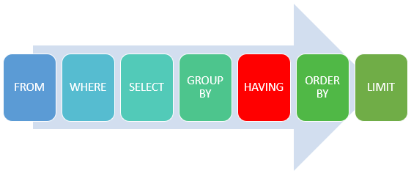
SQL Best Practices
2. Avoid including a HAVING clause in SELECT statements
The HAVING clause is used to filter the rows after all the rows are selected and it is used like a filter.
It works by going through the final result table of the query parsing out the rows that don’t meet the HAVING condition.

Slide 20
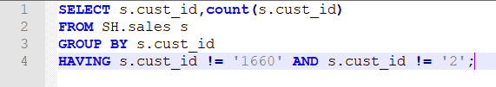
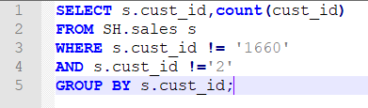
SQL Best Practices
2. Avoid including a HAVING clause in SELECT statements
Original query
Improved query

Slide 21
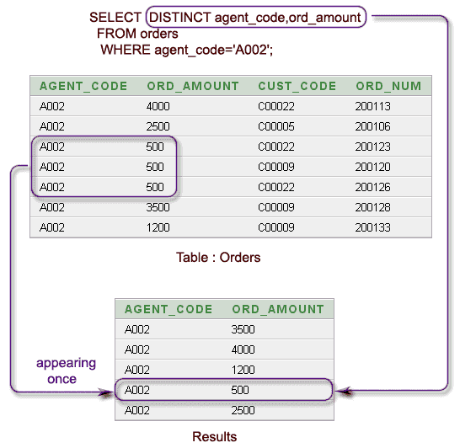
SQL Best Practices
3. Eliminate Unnecessary DISTINCT Conditions
The DISTINCT keyword in the original query is unnecessary because the table_name contains the primary key p.ID, which is part of the result set.

Slide 22
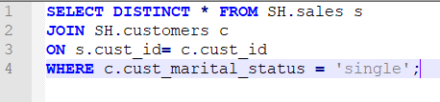
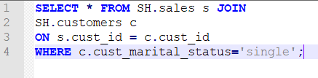
SQL Best Practices
3. Eliminate Unnecessary DISTINCT Conditions
Original query
Improved query

Slide 23
SQL Best Practices
4. Use UNION ALL instead of UNION
The UNION ALL statement is faster than UNION
UNION ALL statement does not consider duplicate s, and
UNION statement does look for duplicates in a table while selection of rows, whether or not they exist.

Slide 24
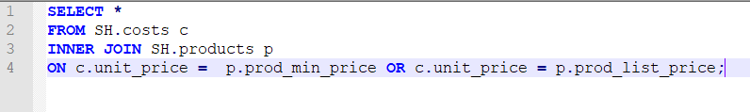
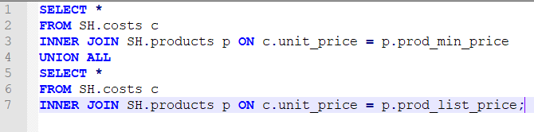
SQL Best Practices
5. Avoid using OR in join conditions
Original query
Improved query

Slide 25
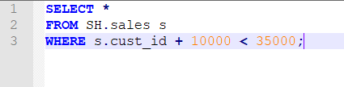

SQL Best Practices
6. Avoid any redundant mathematics
Original query
Improved query

Slide 26
SQL Best Practices
7. Consider using COUNT
COUNT(1) gets converted into COUNT(*) by SQL Server, so there is no difference between these. The 1 is a literal, so a COUNT('whatever') is treated as equivalent.
COUNT(column_name)
If the column_name definition is NOT NULL, this gets converted to COUNT(*).
If the column_name definition allows NULLs, then SQL Server needs to access the specific column to count the non-null values on the column.

Slide 27
SQL Best Practices
7. Consider using COUNT
Never use COUNT(*)
tt must read all columns and cause unnecessary reads.
Always use COUNT(1)
The primary key is the first column in the table and you want it to read the clustered index.
Always use COUNT(column_name)
You can select which index it will scan.

Slide 28
SQL Best Practices
7. Consider using COUNT
Original query
Improved query

Slide 29

Summary

Slide 30

Thank you
30

